Slide 1
Finite Element Simulation For Mechanical Design
Dynamic analyses
Prof. Andrea Bernasconi

Slide 2
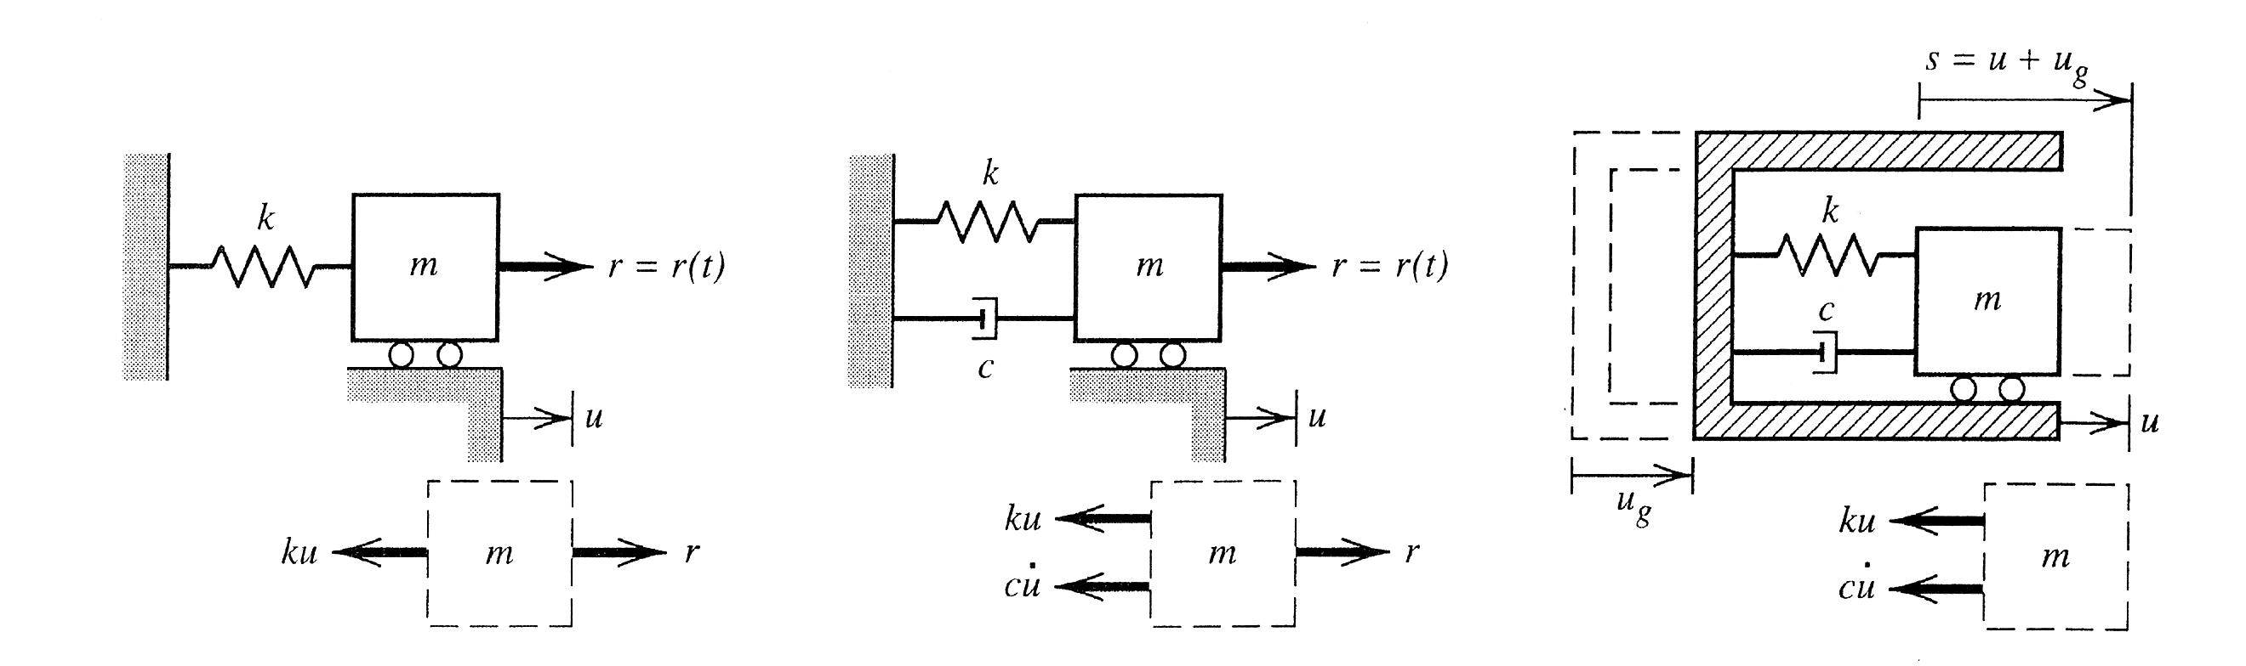

1 D.O.F.
$$ku+m\ddot{u}=r(t) ku+c\dot{u}+m\ddot{u}=r(t)$$
In a system having n d.o.f.
R(t) -> {R}, nodal forces
u -> {D}, nodal displacements
k, c, m scalars -> [K], [C], [M] matrices (in absence of non-linearities, contain only scalars)
$$\left[K\right]\left\{D\right\}+\left[C\right]\left\{\dot{D}\right\}+\left[M\right]\left\{\ddot{D}\right\}=\left\{R(t)\right\}$$

Slide 3

Dynamic analyses
$$\left[K\right]\left\{D\right\}+\left[C\right]\left\{D\right\}+\left[M\right]\left\{\ddot{D}\right\}=\left\{R(t)\right\}$$
In general, given {R(t)}, one wants to know {D(t)} and its derivatives
This implies an integration over time.
It is possible to have less-demanding objectives:
Frequencies and vibration modes
Frequency response

Slide 4
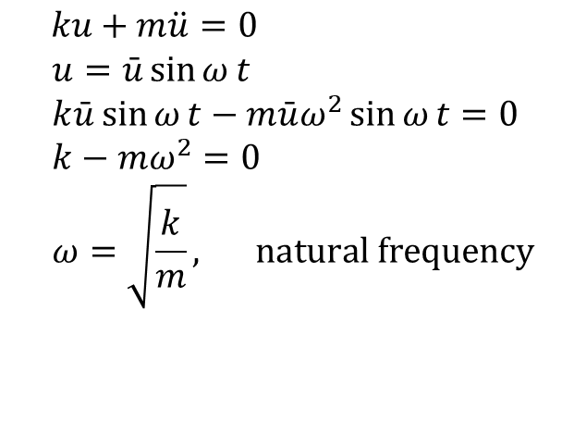
Undamped free vibrations
$ku+m\ddot{u}=0$ $$u=\bar{u}\sin{ω}t \\ k\bar{u}\sin{ω}t−m\bar{u}ω^{2}\sin{ω}t=0 \\ k−mω^{2}=0 \\ ω=\sqrt{\frac{k}{m}}, \text{natural} \text{frequency}$$

Slide 5
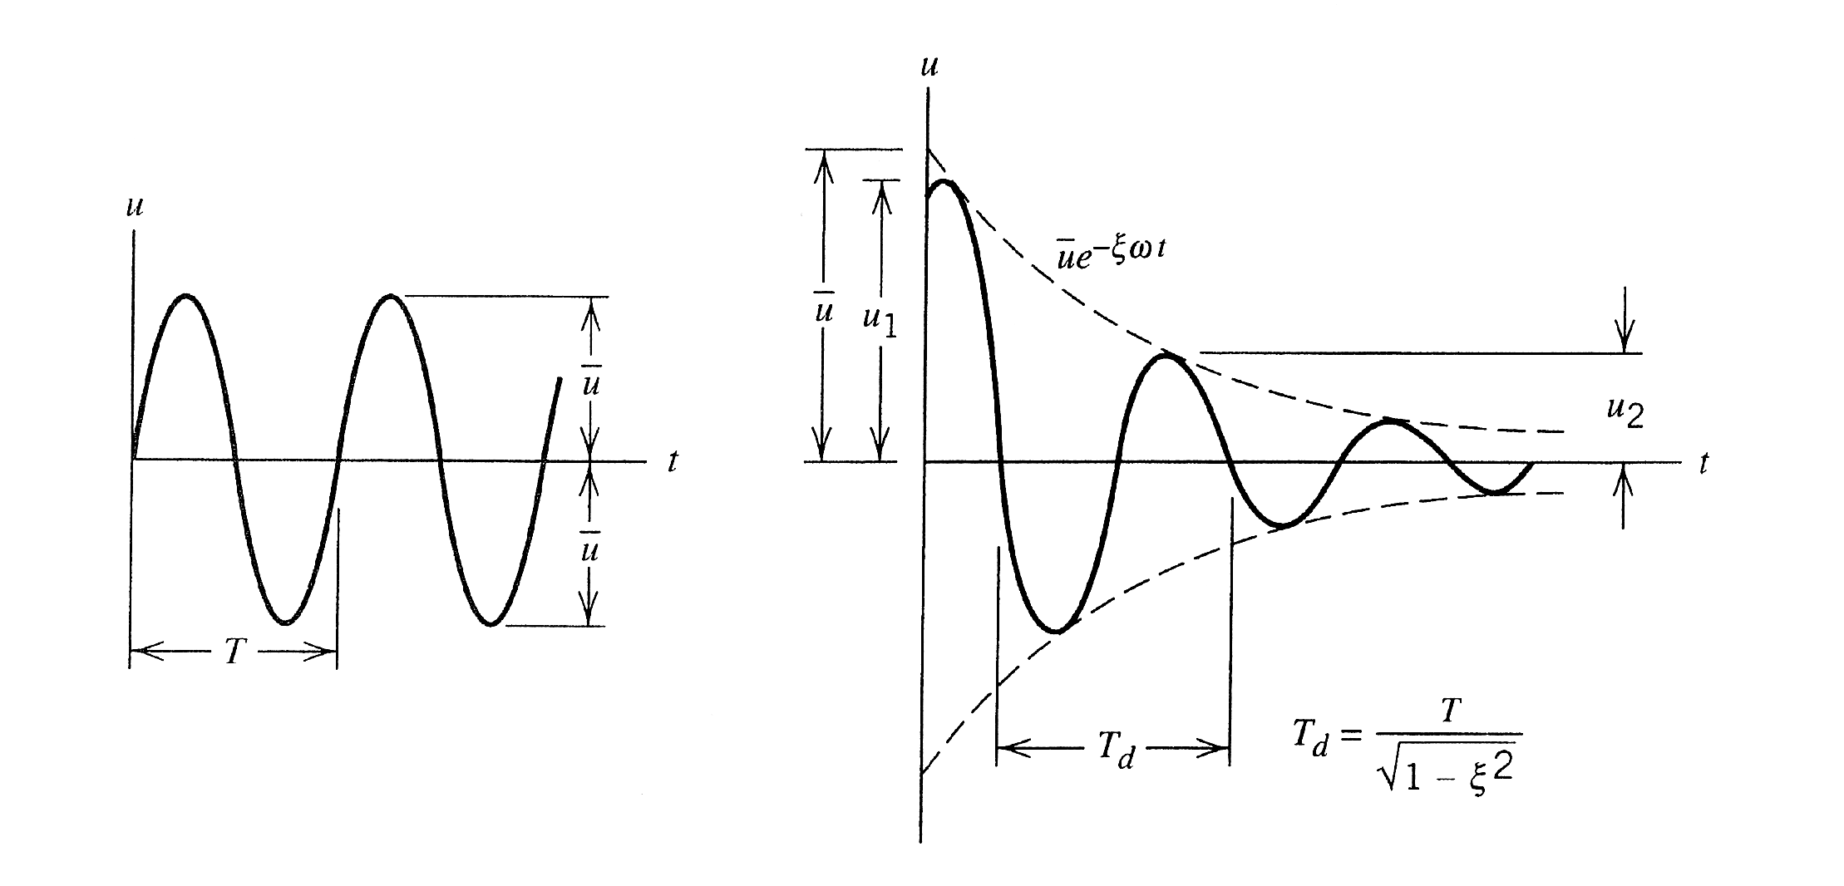
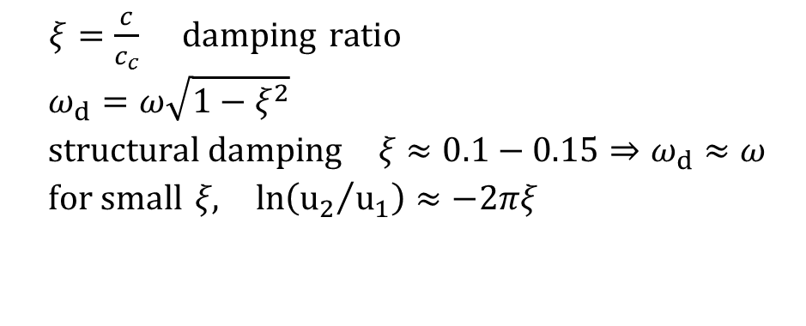
Damped vibrations
With damping, and if c < c_{c} = 2mω, motion is oscillatory, but the amplitude decreases
$ξ=\frac{c}{c_{c}} \text{damping} \text{ratio}$ $$ω_{d}=ω\sqrt{1−ξ^{2}} \\ \text{stru}\text{ctural} \text{damping} ξ≈0.1−0.15⇒ω_{d}≈ω \\ \text{for} \text{small} ξ\text{,} \text{ln}\left({u_{2}}/{u_{1}}\right)≈−2πξ$$

Slide 6

Frequency response
Objective: to find the amplitude of vibrations as an effect of loads that vary sinusoidally with time
Note: if multiple loads are applied, they must have the same frequency
$$r(t)=F_{0}\sin{Ω}t F_{0} \text{costant}$$

Slide 7


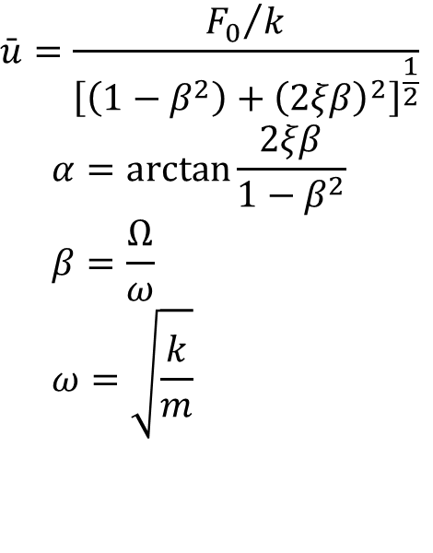
Frequency response: 1 d.o.f.
$$r(t)=F_{0}\sin{Ω}t F_{0} \text{costant}$$
After an initial transient period, that vanishes due to damping, the vibration stabilizes
$$u=\bar{u}\sin\left(Ωt−α\right)$$
$$\bar{u}=\frac{{F_{0}}/k}{{\left[\left(1−β^{2}\right)+{\left(2ξβ\right)}^{2}\right]}^{\frac{1}{2}}} \\ α=\arctan{\frac{2ξβ}{1−β^{2}}} \\ β=\frac{Ω}{ω} \\ ω=\sqrt{\frac{k}{m}}$$
Amplitude is proportional to F₀
Phase shift between u and r
Static deformation F₀ / k is amplified if Ω approaches ω (resonance)

Slide 8
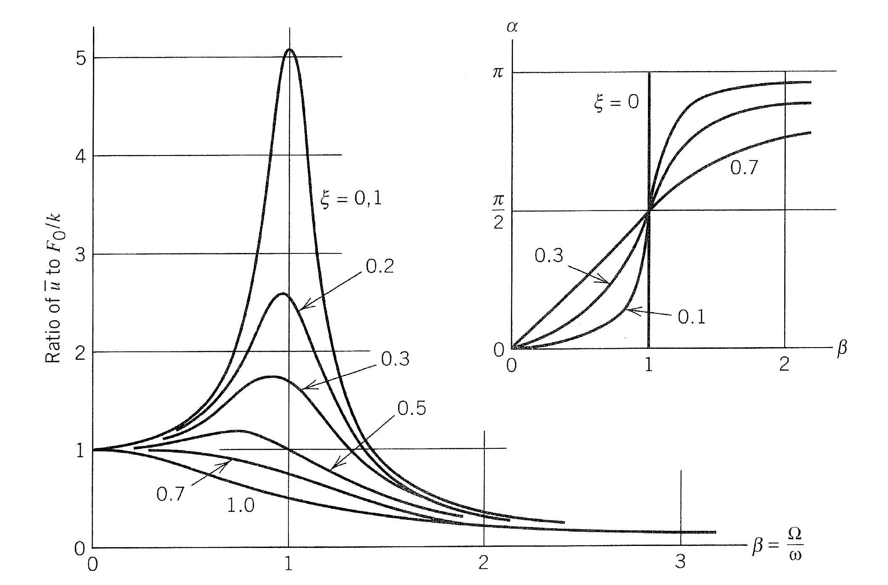
Frequency response: 1 d.o.f.
Systems having n d.o.f. have as many natural frequencies as the number of d.o.f.
Resonance is possible when one of more forces have frequencies close to one of the natural frequencies

Slide 9

Finite Element systems
$$\left[K\right]\left\{D\right\}+\left[C\right]\left\{\dot{D}\right\}+\left[M\right]\left\{\ddot{D}\right\}=\left\{R(t)\right\}$$
Terms appearing in the equation are:
[K] stiffness matrix
[M] mass matrix: m_{ij} are loads to be applied to the i-th degree of freedom to cause a unit acceleration of the j-th d.o.f.
[C] damping matrix

Slide 10
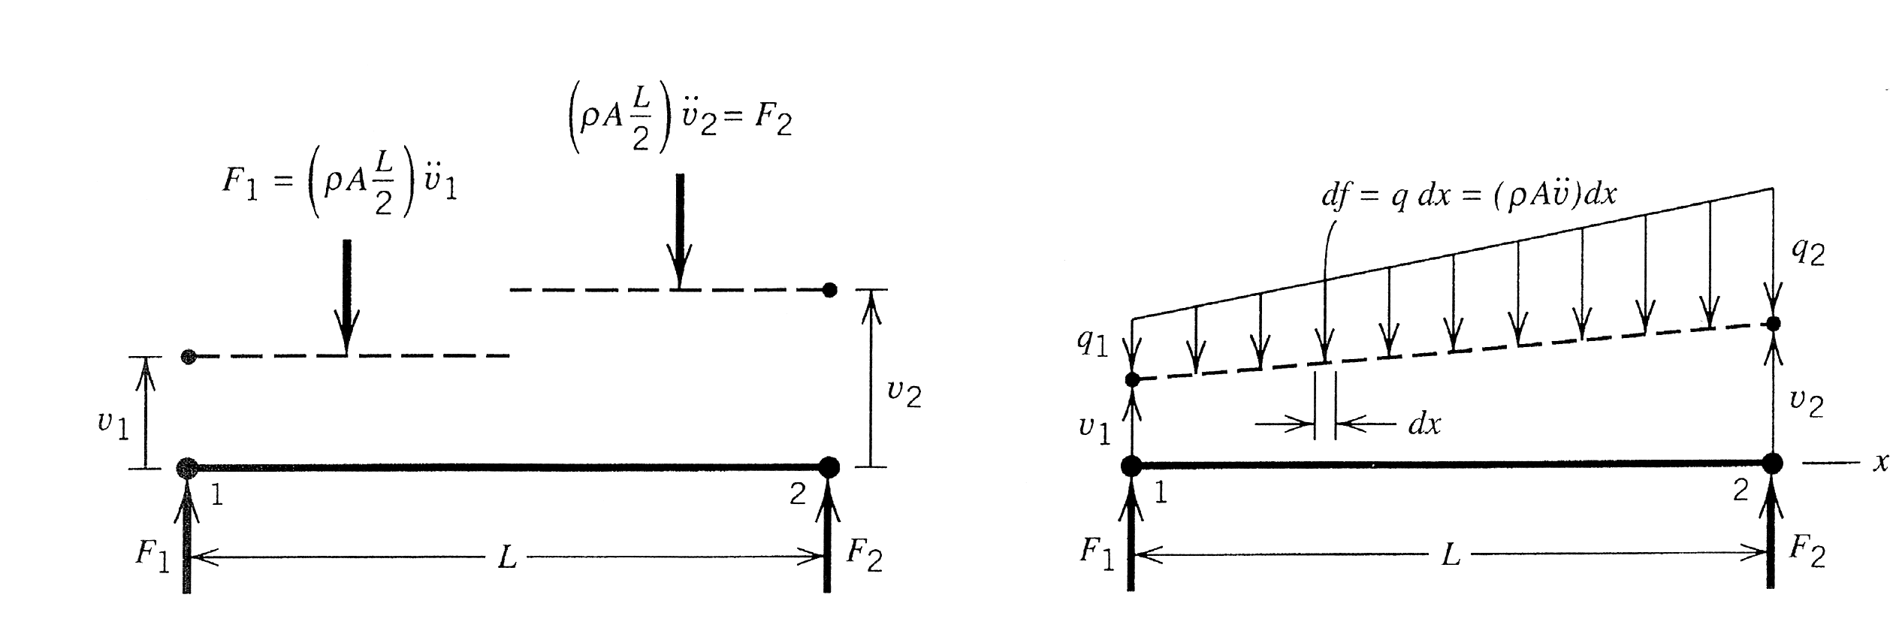
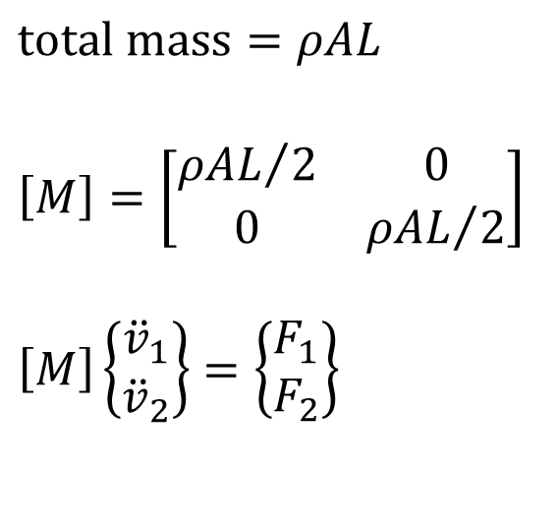
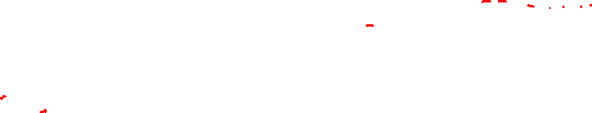
Mass matrix
In [K], the j-th column represents the vector of nodal loads that mantain the displacement field created by a unit value of the j-th d.o.f.
Similarly, in [M], the j-th column represents the vector of nodal loads that mantain the acceleration field created by a unit value of the second derivative of j-th d.o.f.
In a FE model, masses (distributed) can be:
lumped
distributed
Example: beam element
Mass lumping
$$\text{total} \text{mass}=ρAL$$ $$\left[M\right]=\left[\begin{matrix}{ρAL}/2 & 0 \\ 0 & {ρAL}/2\end{matrix}\right]$$ $$\left[M\right]\left\{\begin{matrix}{\ddot{v}}_{1} \\ {\ddot{v}}_{2}\end{matrix}\right\}=\left\{\begin{matrix}F_{1} \\ F_{2}\end{matrix}\right\}$$
M becomes a diagonal matrix
The displacement field is treated as discontinous

Slide 11
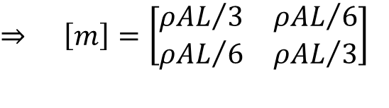
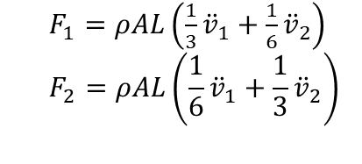
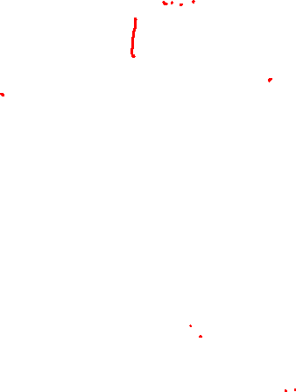
Distributed masses
Inertia is treated like a distributed load
hypothesis: linear variation of v(x)
The load acting on the element dx
By imposing equilibrium
$F_{1}=ρAL\left(\frac{1}{3}{\ddot{v}}_{1}+\frac{1}{6}{\ddot{v}}_{2}\right)$
$$F_{2}=ρAL\left(\frac{1}{6}{\ddot{v}}_{1}+\frac{1}{3}{\ddot{v}}_{2}\right)$$
$$⇒ \left[m\right]=\left[\begin{matrix}{ρAL}/3 & {ρAL}/6 \\ {ρAL}/6 & {ρAL}/3\end{matrix}\right]$$
The M matrix is now full. However, it does not contain m_{ij} associated to the rotational degrees of freedom

Slide 12

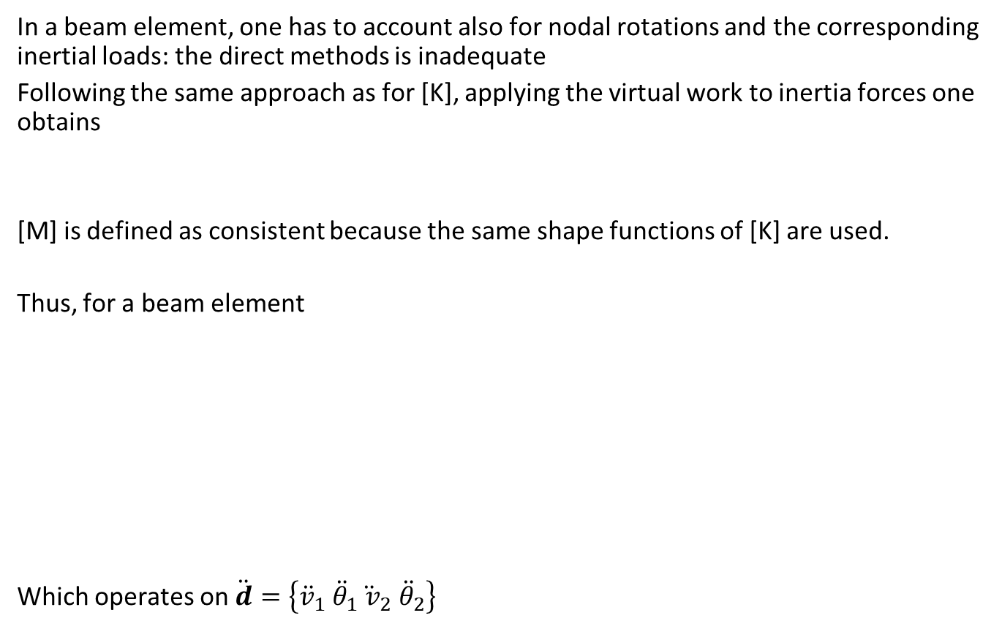
Consistent [M]
In a beam element, one has to account also for nodal rotations and the corresponding inertial loads: the direct methods is inadequate
Following the same approach as for [K], applying the virtual work to inertia forces one obtains
[M] is defined as consistent because the same shape functions of [K] are used.
Thus, for a beam element
Which operates on $\ddot{d}=\left\{{\ddot{v}}_{1}{ \ddot{θ}}_{1}{\ddot{ v}}_{2}{ \ddot{θ}}_{2}\right\}$
$$\left[m\right]=\int_{V}{{\left[N\right]}^{T}\left[N\right]ρdV}$$

Slide 13
Consistent [M]
All previously shown matrices correctly represent the resistance to translational accelerations.
Whether the matrix [M] is consistent or not, proper convergence is assured with mesh refinement if it provides the correct inertia forces for all possible translational accelerations
Particularly, for
compatible elements
fully integrated
[M] consistent
computed ω_{i} are upper bounds of the true ω (convergence from above)
Note: the model is stiffer -> computed ω_{i} are raised

Slide 14

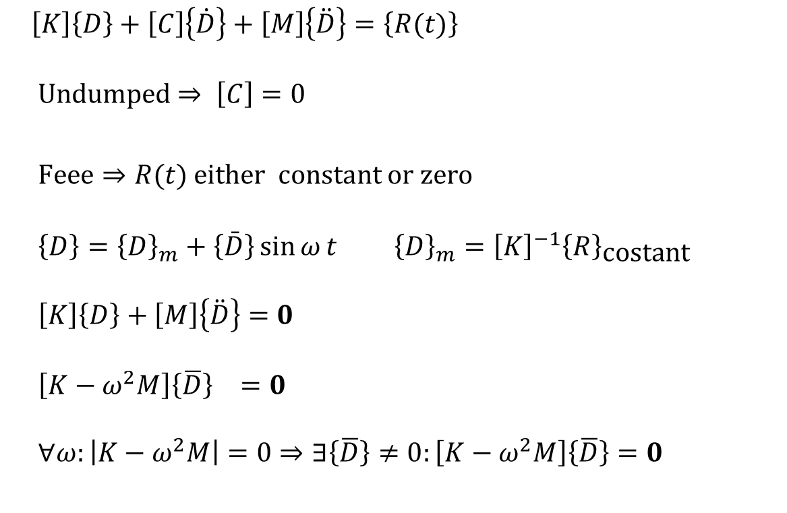
FEM: undamped free vibrations
$\left[K\right]\left\{D\right\}+\left[C\right]\left\{\dot{D}\right\}+\left[M\right]\left\{\ddot{D}\right\}=\left\{R(t)\right\}$ Undumped $⇒ \left[C\right]=0$
$Feee⇒R(t)$ either constant or zero $$\left\{D\right\}={\left\{D\right\}}_{m}+\left\{\bar{D}\right\}\sin{ω}t {\left\{D\right\}}_{m}={\left[K\right]}^{−1}{\left\{R\right\}}_{\text{costant}}$$ $$\left[K\right]\left\{D\right\}+\left[M\right]\left\{\ddot{D}\right\}=0$$ $$\left[K−ω^{2}M\right]{\left\{\overline{D}\right\}}_{}=0$$ $$∀ω:\left|K−ω^{2}M\right|=0⇒∃\left\{\overline{D}\right\}≠0:\left[K−ω^{2}M\right]\left\{\overline{D}\right\}=0$$
$$\left\{\ddot{D}\right\}=−ω^{2}\left\{\bar{D}\right\}\sin{ω}t$$
Eigenvalue problem

Slide 15

FEM: eigenfrequencies and vibration modes
$\left[K−ω^{2}M\right]\left\{\overline{D}\right\}=0$ $$\left\{\overline{D}\right\}=0$$ $$ω_{i}^{2}$$ $${\left\{\overline{D}\right\}}_{i}$$
Trivial solution, we are not interested in
Eigenvalues -> Eigenfrequencies
The corresponding eigenvectors are the vibration modes
Note: the structure can be modelled as free (no boundary conditions); rigid motions, corresponding to ω=0, pose numerical issues, that can be overcome by setting an “eigenvalue shift”

Slide 16
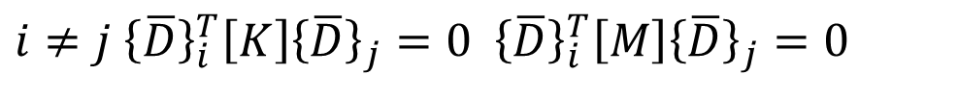

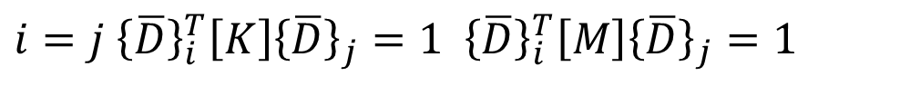
FEM: eigenfrequencies and vibration modes
$$\left[K\right]{\left\{\overline{D}\right\}}_{i}=ω_{i}^{2}\left[M\right]{\left\{\overline{D}\right\}}_{i}$$ $${\left\{\overline{D}\right\}}_{i}$$ $${\left\{\overline{D}\right\}}_{i}^{T}\left[M\right]{\left\{\overline{D}\right\}}_{i}=1$$
Elastic reactions are in equilibrium with inertia loads
Are “modes”: amplitudes are defined up to a multiplicative constant, thus modes are usually normalized
$i≠j$ ${\left\{\overline{D}\right\}}_{i}^{T}\left[K\right]{\left\{\overline{D}\right\}}_{j}=0$ ${\left\{\overline{D}\right\}}_{i}^{T}\left[M\right]{\left\{\overline{D}\right\}}_{j}=0$
Modes are orthogonal wrt [K] and [M]
$i=j$ ${\left\{\overline{D}\right\}}_{i}^{T}\left[K\right]{\left\{\overline{D}\right\}}_{j}=1$ ${\left\{\overline{D}\right\}}_{i}^{T}\left[M\right]{\left\{\overline{D}\right\}}_{j}=1$
n d.o.f. => n ω_{i}, but it is not necessary to evaluate them all, unless in special cases, like impacts, the response of a structure is governed by the first modes only.

Slide 17

Exercise
Find limit ω , such that stress in the wire is equal to σ_{all}
ω
m = 7.26 kg
Steel wire
L = 1000 mm
A = $\frac{π}{4}3^{2}$ mm²
σ_{all} = 235 MPa

Slide 18
Solve the problem and report your results

Slide 19

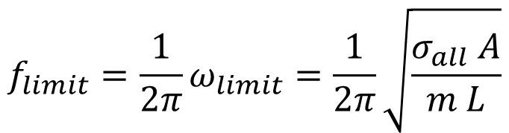

Exercise
Find limit ω , such that stress in the wire is equal to σ_{all}
ω
m = 7.26 kg
$$σ=\frac{F}{A}=\frac{mω^{2}L}{A}$$
Steel wire
L = 1000 mm
A = $\frac{π}{4}3^{2}$ mm²
σ_{all} = 235 MPa
$$ω_{limit}=\sqrt{\frac{σ_{all} A}{m L}}$$
$${f_{limit}=\frac{1}{2π}ω}_{limit}=\frac{1}{2π}\sqrt{\frac{σ_{all} A}{m L}}$$

Slide 20
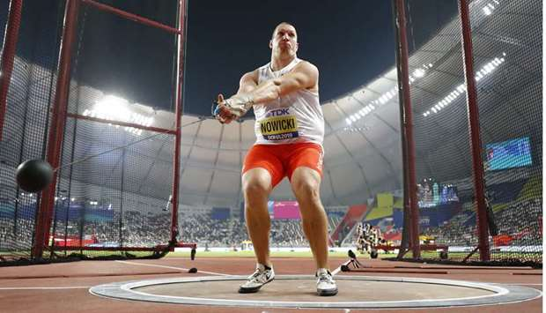
Problem’s data from Hummer Throw

Slide 21
Units!!!
Newton’s law
F = m a
m N s:
Unity acceleration: 1 m/s²
Unit force: 1 N = 1 kg x 1 m/s²
masses must be expressed in kg
density must be expressed in kg/m³
mm N s:
Unity acceleration: 1 mm/s²
Unit force: 1 N = 1000 kg x 1 mm/s²
Masses must be expressed in t = 1000 kg
density must be expressed in t/mm³

Slide 22
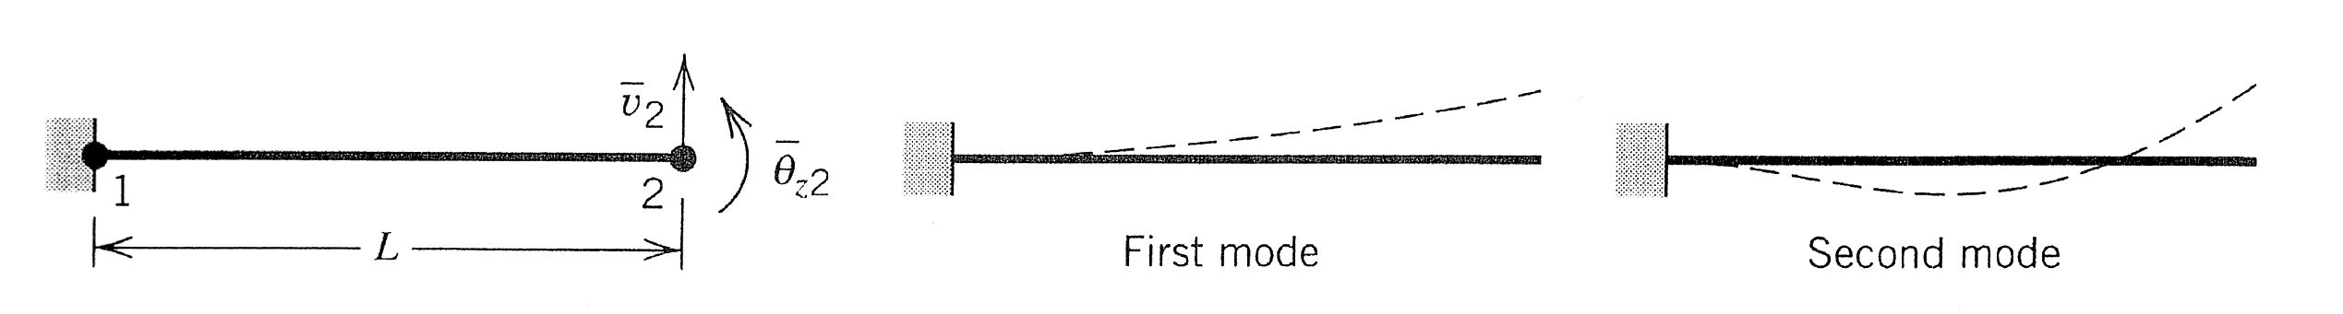

Number of elements
The most appropriate number of elements depends on the number of modes of interest.
The first modes have a small number of nodes and therefore are properly described by a smaller number of elements than higher order modes.
Example: with only one element it is possible to model the first eigen mode, not the second
Let’s see more in Abaqus
$$f_{i}=\frac{1}{2π}\sqrt{\frac{EJ}{ρA}}{\left(\frac{k_{i}}{L}\right)}^{2}$$
K₁ =1.875
K₂ =4.694

Slide 23

Damping matrix
$$\left[K\right]\left\{D\right\}+\left[C\right]\left\{\dot{D}\right\}+\left[M\right]\left\{\ddot{D}\right\}=\left\{R(t)\right\}$$
[C] represents a viscous damping term
Common sources of damping in structures are not viscous (e.g. friction in joints)
The contribution of [C] is small, therefore it can be idealized as viscous
Typical values of the damping ratio are ξ = 0.02 – 0.07

Slide 24
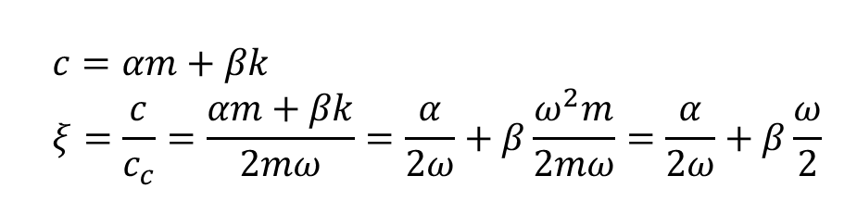

Proportional damping (Rayleigh)
$$\left[C\right]=α\left[M\right]+β\left[K\right]$$
Arbitrary definition, no physical meaning
Damping depends on frequency. E.g. for a 1 d.o.f. system:
$$c=αm+βk \\ ξ=\frac{c}{c_{c}}=\frac{αm+βk}{2mω}=\frac{α}{2ω}+β\frac{ω^{2}m}{2mω}=\frac{α}{2ω}+β\frac{ω}{2}$$

Slide 25
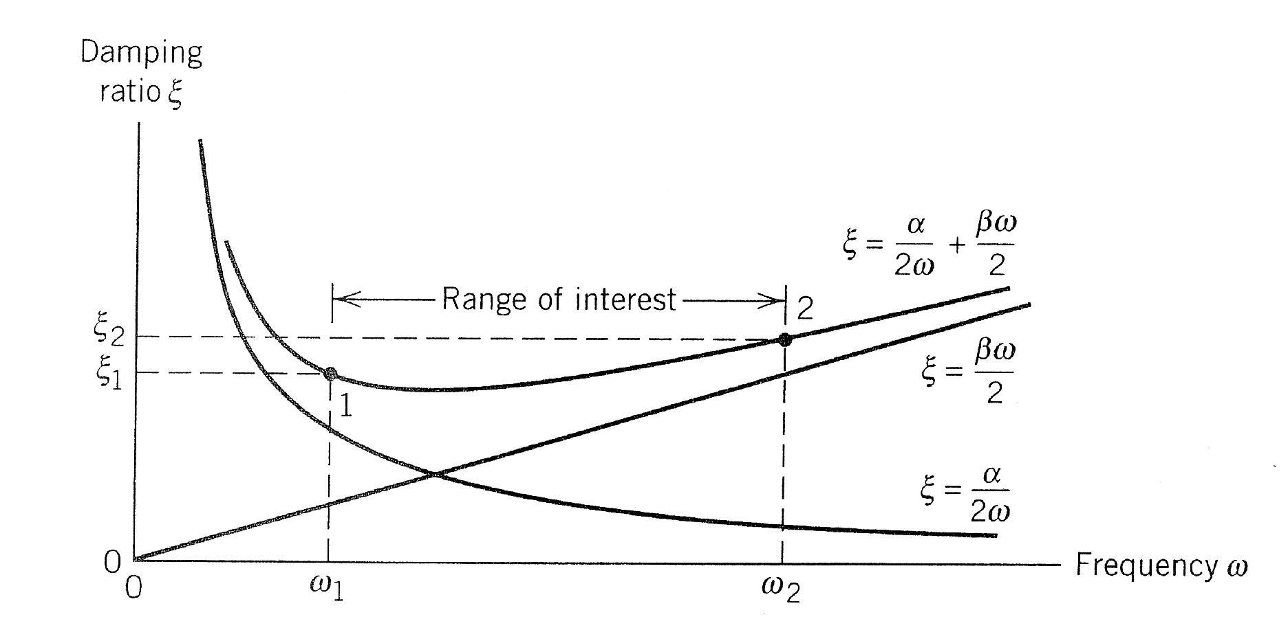
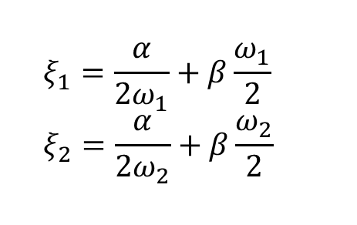
Proportional damping (Rayleigh)
4 values ξ₁, ξ₂, ω₁,ω₂ are chosen and the system solved
$$ξ_{1}=\frac{α}{2ω_{1}}+β\frac{ω_{1}}{2} \\ ξ_{2}=\frac{α}{2ω_{2}}+β\frac{ω_{2}}{2}$$

Slide 26
Proportional damping (Rayleigh)
With this definition, one must accept the curve between points 1 and 2 as a satisfactory representation of damping over the range ω₁<ω<ω₂
It demands infinite damping for ω -> 0
Another way is modal damping -> modal equations

Slide 27



Modal equations
Coordinate transformation: from PHYSICAL to MODAL, in the solution of the problem
$$\left[K\right]\left\{D\right\}+\left[C\right]\left\{\dot{D}\right\}+\left[M\right]\left\{\ddot{D}\right\}=\left\{R(t)\right\}$$
I step)
Normalization of the eigenvectors with respect to the mass matrix
And therefore
$${\left\{\bar{D}\right\}}_{i}^{T}\left[M\right]{\left\{\bar{D}\right\}}_{i}=1$$
$${\left\{\bar{D}\right\}}_{i}^{T}\left[K\right]{\left\{\bar{D}\right\}}_{i}={ω_{i}}^{2}$$

Slide 28



Modal equations
II step)
Build the modal matrix [Φ]
n is the number of the free d.o.f. (not suppressed by constraints or boundary conditions)
And the matrix
For the orthogonality of modes
$$\left[Φ\right]=\left[{\bar{D}}_{1} {\bar{D}}_{2} {\bar{D}}_{3} …{\bar{D}}_{n}\right]$$
$$\left[ω^{2}\right]=\text{diag}\left(ω_{1}^{2} ω_{2}^{2} …ω_{n}^{2}\right)$$
$${\left[Φ\right]}^{T}\left[M\right]\left[Φ\right]=\left[I\right] \\ {\left[Φ\right]}^{T}\left[K\right]\left[Φ\right]=\left[ω^{2}\right]$$

Slide 29
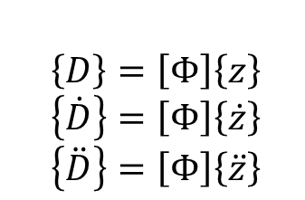
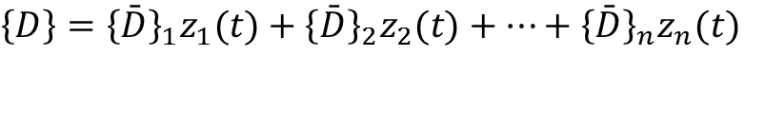

Modal equations
III) step
{D(t)} is expressed as a combination of the n {D}_{i}, i.e.
z_{i} are the modal coordinates
$$\left\{D\right\}={\left\{\bar{D}\right\}}_{1}z_{1}(t)+{\left\{\bar{D}\right\}}_{2}z_{2}(t)+…+{\left\{\bar{D}\right\}}_{n}z_{n}(t)$$
$$\left\{D\right\}=\left[Φ\right]\left\{z\right\}$$
$$\left\{\dot{D}\right\}=\left[Φ\right]\left\{\dot{z}\right\} \\ \left\{\ddot{D}\right\}=\left[Φ\right]\left\{\ddot{z}\right\}$$
$$z= \left\{\begin{aligned}\begin{matrix}z_{1}(t) \\ z_{2}(t)\end{matrix} \\ ⋮ \\ z_{n}(t)\end{aligned}\right\}$$

Slide 30



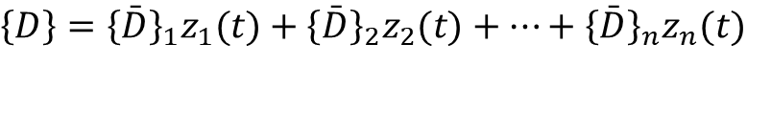
Modal equations
IV step)
substitute {D} and its derivatives with $\left[Φ\right]\left\{z\right\}$ and its derivatives, and pre-multiply by [Φ]^{T}
hence
$$\left\{D\right\}={\left\{\bar{D}\right\}}_{1}z_{1}(t)+{\left\{\bar{D}\right\}}_{2}z_{2}(t)+…+{\left\{\bar{D}\right\}}_{n}z_{n}(t)$$
$$\left[M\right]\left[Φ\right]\left\{\ddot{z}\right\}+\left[C\right]\left[Φ\right]\left\{\dot{z}\right\}+\left[K\right]\left[Φ\right]\left\{z\right\}=\left\{R(t)\right\}$$
$${\left[Φ\right]}^{T}\left[M\right]\left[Φ\right]\left\{\ddot{z}\right\}+{\left[Φ\right]}^{T}\left[C\right]\left[Φ\right]\left\{\dot{z}\right\}+{\left[Φ\right]}^{T}\left[K\right]\left[Φ\right]\left\{z\right\}={\left[Φ\right]}^{T}\left\{R(t)\right\}$$
${\left[Φ\right]}^{T}\left[M\right]\left[Φ\right]=$ $\left[I\right]$
$${\left[Φ\right]}^{T}\left[K\right]\left[Φ\right]=diag ω^{2}=\left[ω^{2}\right]$$
${\left[Φ\right]}^{T}\left[C\right]\left[Φ\right]=$ $\left[C_{Φ}\right]$
$$\left\{\ddot{z}\right\}+\left[C_{Φ}\right]\left\{\dot{z}\right\}+\left[ω^{2}\right]\left\{z\right\}=\left\{R_{Φ}(t)\right\}$$

Slide 31

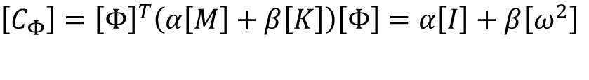

Modal equations
V step)
Express damping as:
proportional
in this case [C_{Φ}] is diagonal
b) modal
In any case the equations are fully uncoupled
$$\left[C_{Φ}\right]={\left[Φ\right]}^{T}\left(α\left[M\right]+β\left[K\right]\right)\left[Φ\right]=α\left[I\right]+β\left[ω^{2}\right]$$
$$\left[C_{Φ}\right]≡diag\left(2ξ_{i}ω_{i}\right)$$
$${\ddot{z}}_{i}+2ξ_{i}ω_{i}{\dot{z}}_{i}+ω_{i}^{2}z_{i}=p_{i}(t)$$
$$p_{i}(t)={\left\{Φ\right\}}_{i}^{T}\left\{R(t)\right\}$$
Function of time

Slide 32

Modal equations: analysis
$${\ddot{z}}_{i}+2ξω_{i}{\dot{z}}_{i}+ω_{i}^{2}z_{i}=p_{i}(t)$$
These equations can be integrated:
in closed form, only in few cases
more in general, by direct integration, for known boundary conditions
Boundary conditions are expressed as known values of {D} and {dD/dt} at t=0

Slide 33
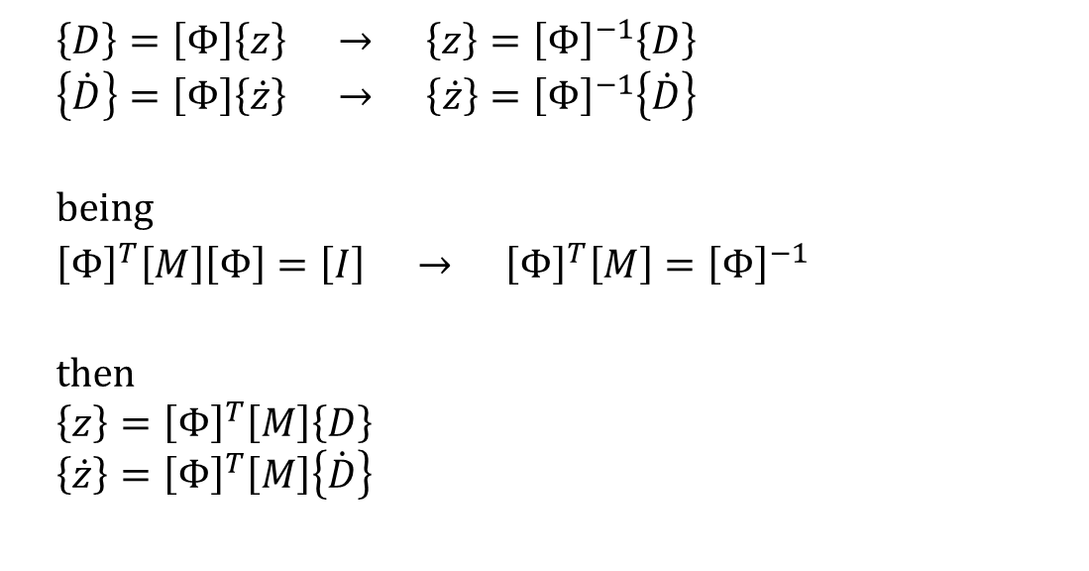
Modal equations: boundary conditions
To obtain the values of {z} and {dz/dt} at t=0
$\left\{D\right\}=\left[Φ\right]\left\{z\right\} → \left\{z\right\}={\left[Φ\right]}^{−1}\left\{D\right\}$ $$\left\{\dot{D}\right\}=\left[Φ\right]\left\{\dot{z}\right\} → \left\{\dot{z}\right\}={\left[Φ\right]}^{−1}\left\{\dot{D}\right\}$$
$$\text{being} \\ {\left[Φ\right]}^{T}\left[M\right]\left[Φ\right]=\left[I\right] → {\left[Φ\right]}^{T}\left[M\right]={\left[Φ\right]}^{−1}$$
$$\text{then} \\ \left\{z\right\}={\left[Φ\right]}^{T}\left[M\right]\left\{D\right\} \\ \left\{\dot{z}\right\}={\left[Φ\right]}^{T}\left[M\right]\left\{\dot{D}\right\}$$

Slide 34

Modal equations: advantages
For many practical problems, we need not use all n modes, only the lowest few m modes need be retained, with m << n
$$\left\{D\right\}=\sum_{i=1}^{m}{{\left\{Φ\right\}}_{i}z_{i}}$$
Therefore, only the first m modes need to be evaluated.
Suitable for problems where only the first modes are activated.
Not suitable for shock loadings, where higher order modes can be activated.

Slide 35

Frequency response: 1 d.o.f.
$$\left\{R(t)\right\}=\left\{\bar{F}\right\}\sin{Ω}t$$
Need being considered all modes up to the first frequency greater than 2Ω

Slide 36


Exercise
$$F=3000 sinΩt$$
$$48 ≤ \frac{Ω}{2π}≤180$$

Slide 37
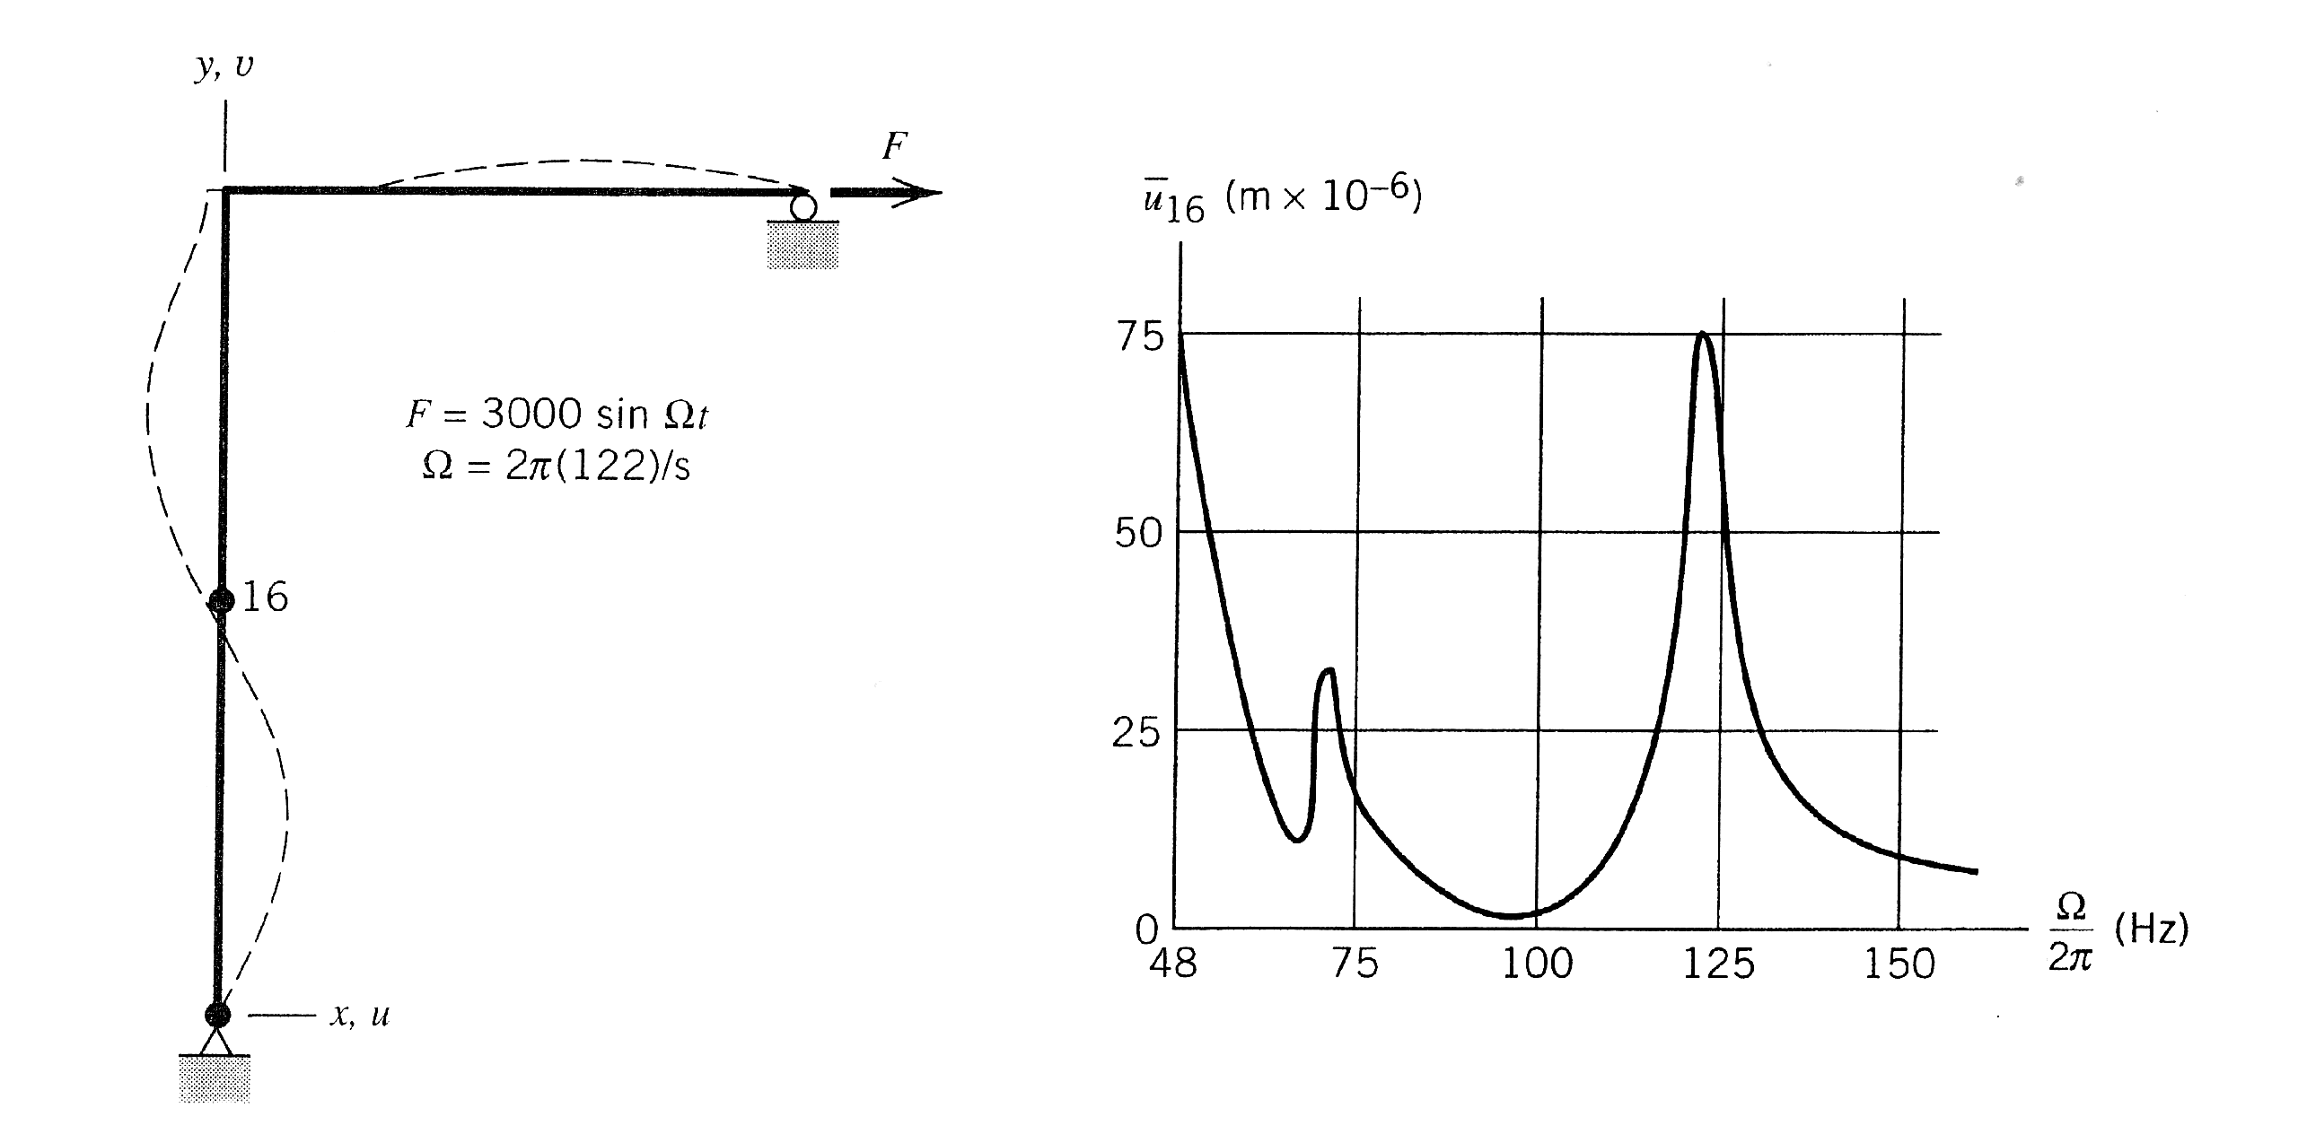
Frequency response: example

Slide 38
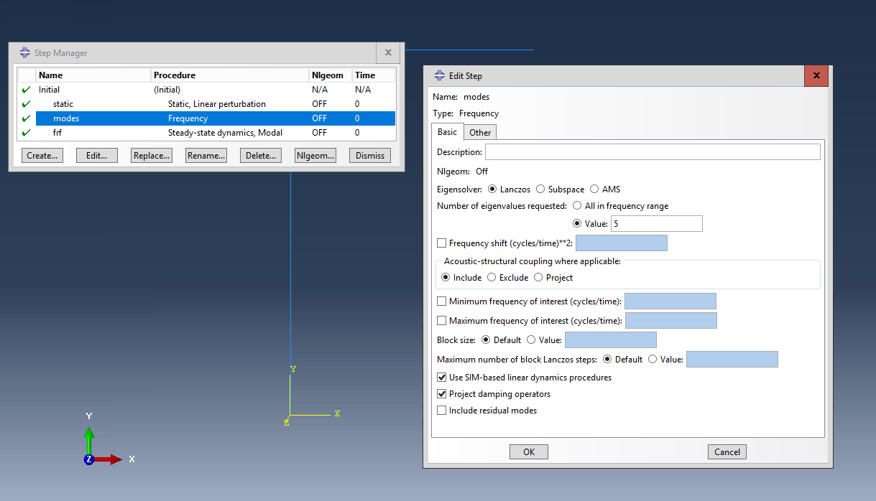

Slide 39
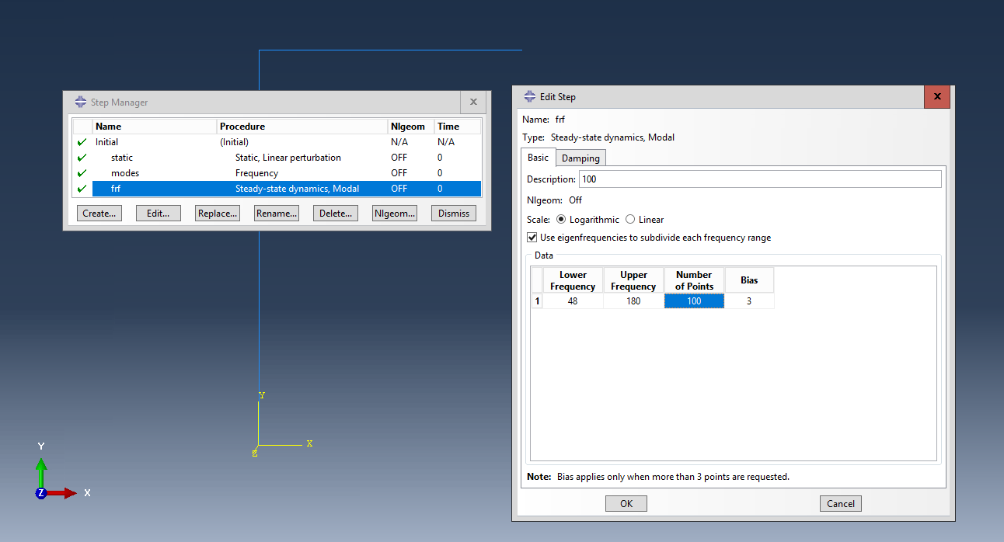
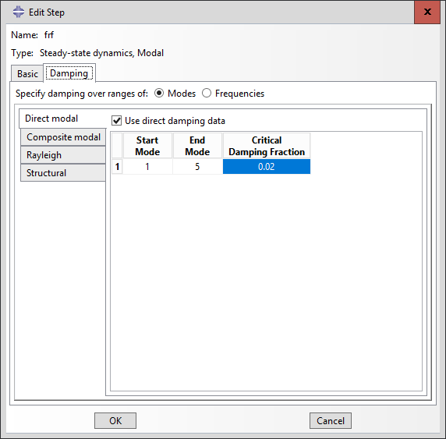

Slide 40
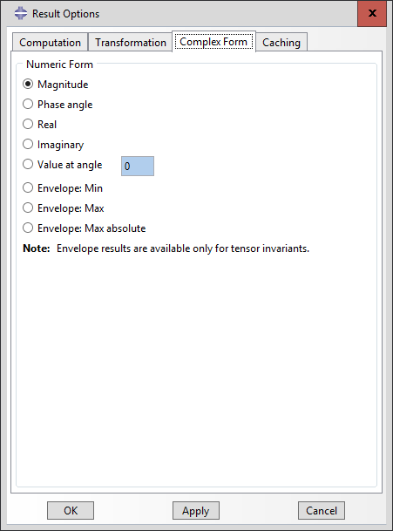
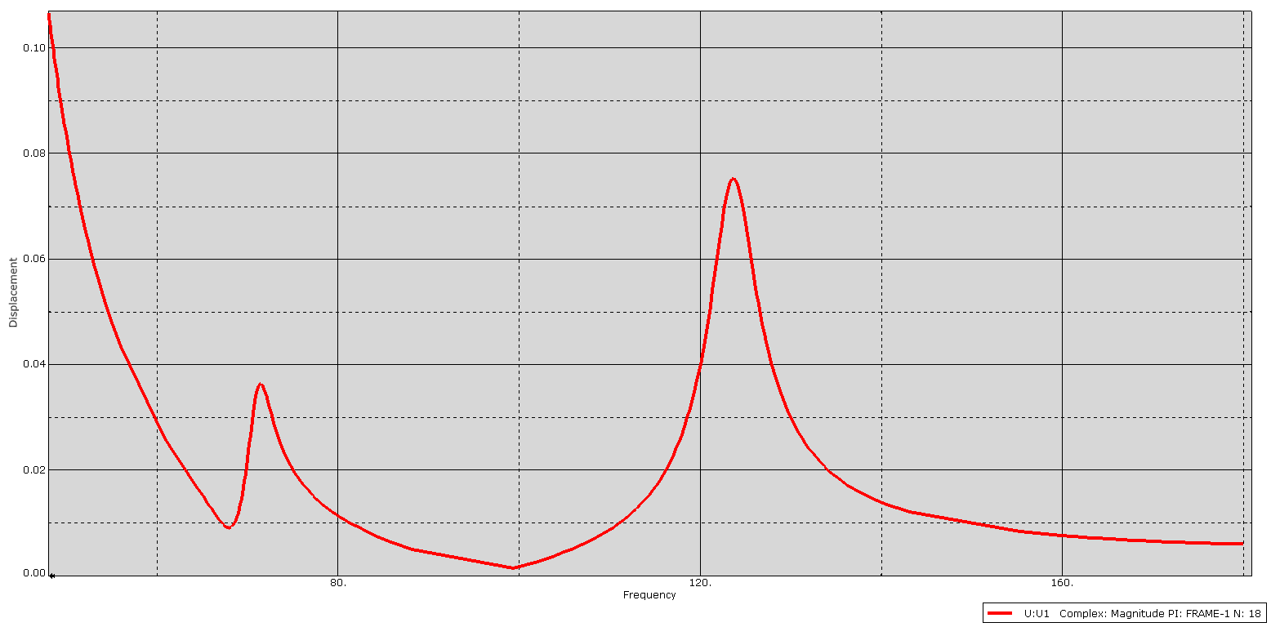
FRF plot at node 18

Slide 41
Assignments
Estimate f₁
Compare static U1 with dynamic U1 of node 18 (i.e. node 16 in the textbook - different modellers may assign different node numbers) at 122 Hz
Estimate U1 of node 18 at 122 Hz
Compare static RF with dynamic RF at 122 Hz at node 1

Slide 42
Estimate f₁
m₂
m₂/2
m₂/2
m₁/2
m₁
m₁/2

Slide 43
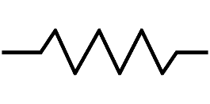
Estimate f₁
k_{eq}
m₁/2
m₁/2
m₁
m₂/2
m₁
m₂/2

Slide 44
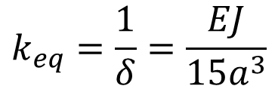
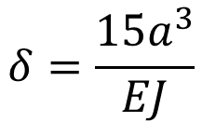
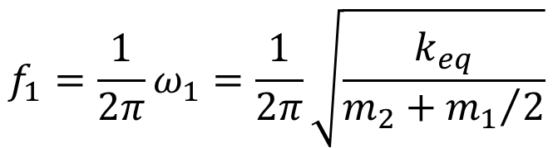
Estimate f₁
δ = 1 / k_{eq}
length = 2 a
F = 1
length = 3 a
$$δ=\frac{15a^{3}}{EJ}$$
$$k_{eq}=\frac{1}{δ}=\frac{EJ}{15a^{3}}$$
$${f_{1}=\frac{1}{2π}ω}_{1}=\frac{1}{2π}\sqrt{\frac{k_{eq}}{m_{2}+{m_{1}}/2}}$$

Slide 45
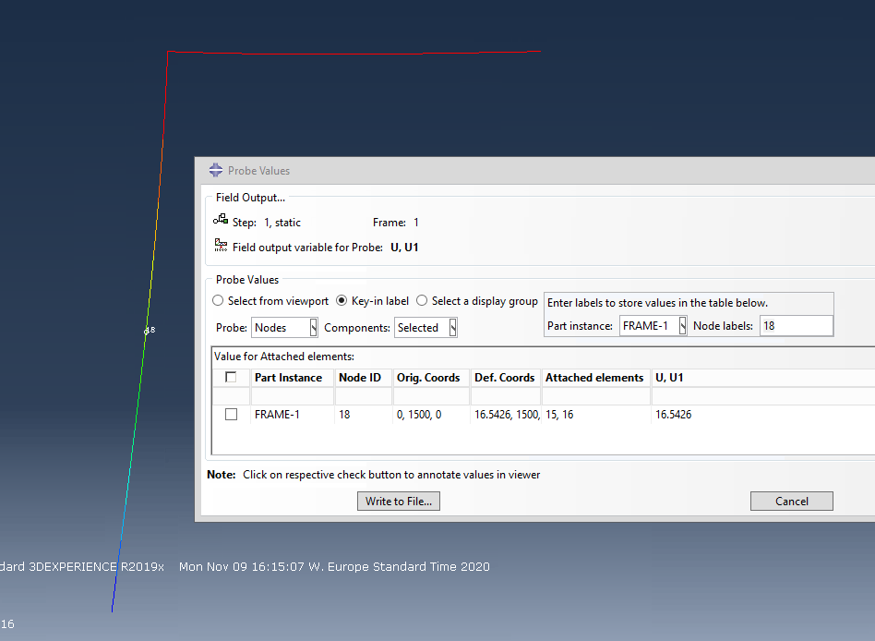
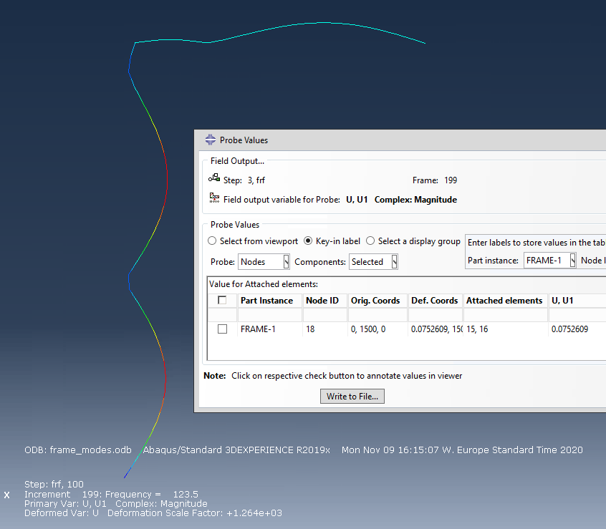
Compare static U1 with dynamic U1 of node 18 at f₄

Slide 46


Compare static RF with dynamic RF at f₄ at node 1

Slide 47

Estimate U1 of node 18 at f₄
p₄ = 0.684531 x 3000 = 2053.6
f₄ = 123.54
ω₄ = 2π (123.54) = 776.2
z₄ = (p₄/ω₄²)/(2 ξ) = (2053.6 / 776.2²)/(2 x 0.02) = 0.0852
U1 (node 18) = z₄ x 0.880017 = 0.075 mm

Slide 48
Time domain analyses
Direct integration, step by step
There are n time steps, separated by a given Δt
At each step
Δt, 2 Δt, 3 Δt, …, n Δt
The equation of motion is
if the problem is linear, otherwise
By direct integration, conditions at step n+1 are calculated from
the equation of motion
a difference expression
known conditions at one or more preceding step times
$$\left[K\right]{\left\{D\right\}}_{n}+\left[C\right]{\left\{\dot{D}\right\}}_{n}+\left[M\right]{\left\{\ddot{D}\right\}}_{n}={\left\{R^{ext}\right\}}_{n}$$
$${\left\{R^{int}\right\}}_{n}+\left[C\right]{\left\{\dot{D}\right\}}_{n}+\left[M\right]{\left\{\ddot{D}\right\}}_{n}={\left\{R^{ext}\right\}}_{n}$$

Slide 49
Time domain analyses
The discretization of the time derivatives is usually achieved by the finite differences' method.
According to the formulation of the finite differences (forward, backward, central), two classes of methods exist:
Implicit, which uses a difference expression of the type
combined with the equation of motion at step n+1
Explicit, which uses a difference expression of this type
combined with the equation of motion at step n
$${\left\{D\right\}}_{n+1}=f\left({\left\{\ddot{D}\right\}}_{n+1},{\left\{\dot{D}\right\}}_{n+1},{\left\{\ddot{D}\right\}}_{n},{\left\{\dot{D}\right\}}_{n},{\left\{D\right\}}_{n},…\right)$$
$${\left\{D\right\}}_{n+1}=f\left({\left\{\ddot{D}\right\}}_{n},{\left\{\dot{D}\right\}}_{n},{\left\{D\right\}}_{n},{\left\{\ddot{D}\right\}}_{n−1},{\left\{\dot{D}\right\}}_{n−1},…\right)$$

Slide 50
Implicit and explicit methods
Explicit methods are conditionally stable
there exist a critical Δt, above which the solution becomes unstable
the solution at each step is faster (the matrix of the coefficients of {D}_{n+1} can be made diagonal)
The critical Δt is usually small; therefore, many more time steps are required than by implicit methods, but the solution of each step is fasted (up to 4000 times for 3D problems)
suitable for wave propagation problems (impact, burst, crash)
Implicit methods are unconditionally stable
Solation is stable for any Δt (although accuracy will suffer …)
The coefficient matrix of {D}_{n+1} cannot be made diagonal -> higher computational costs at each step (but fewer steps that with an explicit solver)
Suitable for structural problems (when the rise time and duration of the load exceeds a few multiples of the time required for a sound wave to travel through the structure)

Slide 51
Explicit methods
Centra differences
Retaining only the terms up to Δt²

Slide 52
Substituting
in
one obtains

Slide 53

Stability
Equation
is conditionally stable, i.e. it can be shown that the solution may diverge unless
where frequency ω_{max} and its period T_{m} corresponds to the highest natural frequency of $\left(\left[K\right]−ω^{2}\left[M\right]\right)\left\{D\right\}= \left\{0\right\}$

